Slide 1

ENGINEERING CHEMISTRY
Lata Pasupulety
Department of Science and Humanities

Slide 2

ENGINEERING CHEMISTRY
Module 4- Electrochemical equilibria
Class content:
Types of electrodes
Metal-metal-ion electrode
Metal-insoluble salt –ion electrode
Gas electrode
Amalgam electrode
Redox electrode
Ion selective electrode

Slide 3
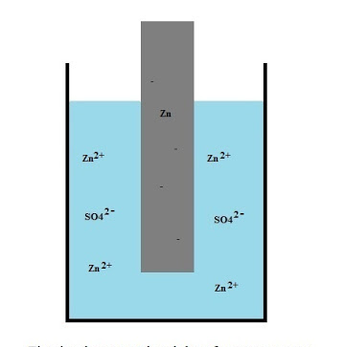

ENGINEERING CHEMISTRY
Module 4- Electrochemical equilibria
Types of electrodes
In order to form a cell, 2 half cells or 2 electrodes are required
Various types of electrodes are available which are constructed based on the application
1. Metal-metal ion electrode:
Metal in contact with a solution of its
own ions
e.g., Zn/Zn²⁺, Cu/Cu²⁺, Ag/Ag⁺
M^{n+} + ne⁻ ⇌ M
Nernst equation
Source:http://www.valgetal.com/physics/Batteries/batteries.htm

Slide 4
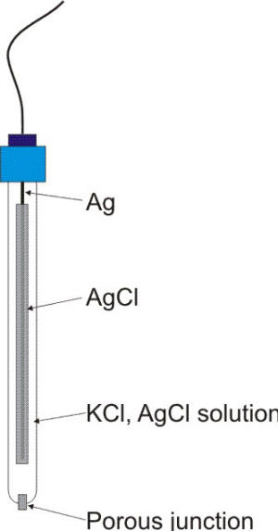
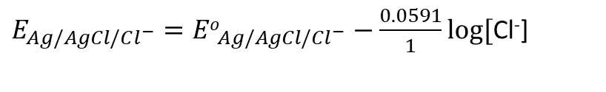
ENGINEERING CHEMISTRY
Module 4- Electrochemical equilibria
2. Metal-Metal insoluble salt- ion electrode:
These electrodes consist of a metal in contact with a sparingly
soluble salt of the same metal dipped in a solution of soluble
salt of the same anion
e.g.,Calomel electrode Hg/Hg₂Cl₂/KCl, Ag/AgCl(s)/HCl
For silver –silver chloride electrode
AgCl + e⁻ ⇌ Ag + Cl⁻
Nernst equation:
$E_{Ag/AgCl/Cl^{−}}={Eo}_{Ag/AgCl/Cl^{−}}−\frac{0.0591}{1}\log{[}$Cl⁻]
Source:https://www.corrosion-doctors.org/Corrosion-Thermodynamics/Reference-Half-Cells-Silver.htm

Slide 5
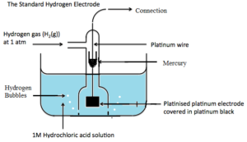
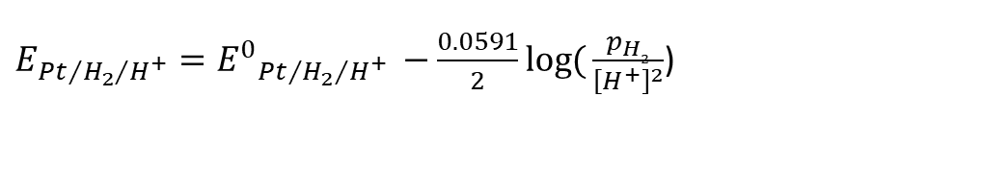
ENGINEERING CHEMISTRY
Module 4- Electrochemical equilibria
3. Gas electrode:
It consists of gas bubbling about an inert metal foil, immersed in solution containing ions to which the gas is reversible.
The metal provides electrical contact and facilitates the establishment of equilibrium between the gas and its ions
e.g.,Hydrogen electrode Pt/H₂/H⁺,Chlorine electrode Pt/Cl₂/Cl⁻
For a hydrogen electrode
2H⁺ + 2e⁻ ⇌ H₂
Nernst equation:
$E_{P{t/{H_{2}}}/{H^{+}}}={E^{0}}_{P{t/{H_{2}}}/{H^{+}} }−\frac{0.0591}{2}\log{(}\frac{p_{H2}}{{\left[H^{+}\right]}^{2}}$)
Source:https://thefactfactor.com/facts/pure_science/chemistry/physical-chemistry/reference-electrodes/5844/

Slide 6
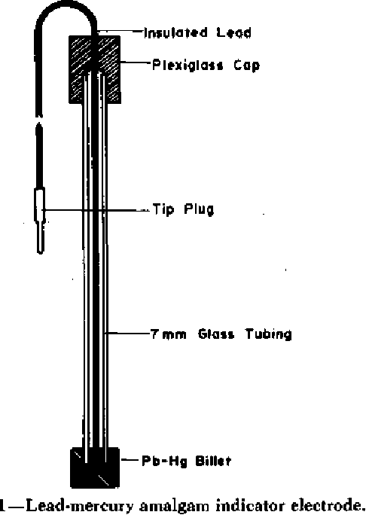
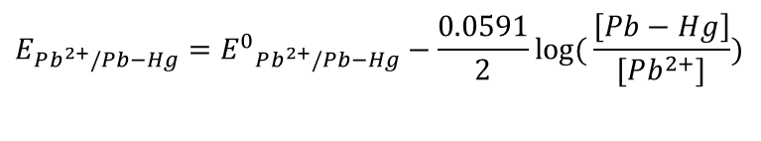
ENGINEERING CHEMISTRY
Module 4- Electrochemical equilibria
4. Amalgam electrode:
It is similar to metal- metal ion electrode in which metal amalgam
is in contact with a solution containing its own ions
e.g., Lead amalgam electrode Pb-Hg/Pb²⁺
For lead amalgam electrode
Pb²⁺ + 2e⁻ ⇌ Pb-Hg
Nernst equation:
$$E_{Pb^{2+}/Pb−Hg}={E^{0}}_{Pb^{2+}/Pb−Hg}−\frac{0.0591}{2}\log{(}\frac{\left[Pb−Hg\right]}{[Pb^{2+}]})$$
Source:https://www.semanticscholar.org/paper/Potentiometric-Titration-of-Sulfate-in-Water-and-a-Robbins-Carter/c823ab0578481e876975ee707a5f8adca14c512f

Slide 7
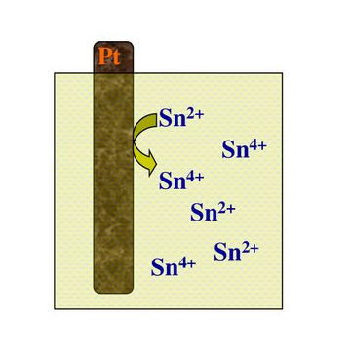
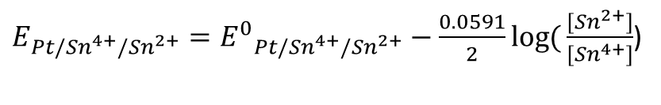
ENGINEERING CHEMISTRY
Module 4- Electrochemical equilibria
5. Oxidation - reduction electrode :
It consists of an inert metal such as platinum immersed in a solution
containing an appropriate oxidized and reduced form of redox system.
The metal merely acts as electrical contact.
The potential arises due to the tendency of one form to change in
to other form.
e.g.,Pt/Fe²⁺,Fe^{3+,} Pt/Ce³⁺,Ce^{4+ ,} Pt/Sn²⁺,Sn⁴⁺
For stannous stannic electrode
Sn⁴⁺ + 2e⁻ ⇌ Sn²⁺
Nernst equation:
$E_{Pt/Sn^{4+}/Sn^{2+}}={E^{0}}_{Pt/Sn^{4+}/Sn^{2+}}−\frac{0.0591}{2}\log{(}\frac{{[Sn}^{2+}]}{{[Sn}^{4+}]}$)
Source:https://slideplayer.com/slide/13860805/

Slide 8
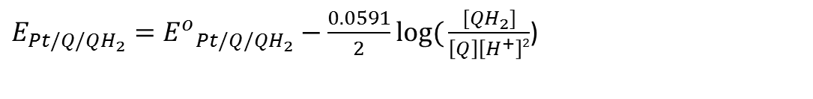
ENGINEERING CHEMISTRY
Module 4- Electrochemical equilibria
Quinhydrone electrode
It consists of an inert metal such as platinum immersed in a
solution containing quinone and hydroquinone
The metal merely acts as electrical contact
The potential arises due to the tendency of quinone to change
to hydroquinone
Pt/Q,QH₂
Nernst equation:
$E_{Pt/Q/QH_{2}}={E^{o}}_{Pt/Q/QH_{2}}−\frac{0.0591}{2}\log{(}\frac{[QH_{2}]}{\left[Q\right]\left[H^{+}\right]2}$)

Slide 9
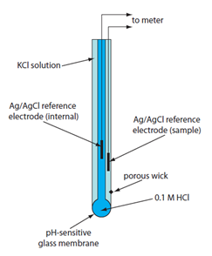
ENGINEERING CHEMISTRY
Module 4- Electrochemical equilibria
6. Ion selective electrode:(membrane electrode)
It consists of a membrane in contact with a solution, with which
it can exchange ions.
e.g., glass electrode: selective to H⁺, Na⁺, K+ etc.
Equation for determining potential for pH sensitive Glass electrode
E_{G} = E⁰_{G} + 0.0591 log₁₀[H⁺]
Source:Analytical Chemistry 2.0, David Harvey, community.asdlib.org/activele...line-textbook/

Slide 10
THANK YOU
Lata Pasupulety
Department of Science and Humanities
latapasupulety@pes.edu
+91 80 6666 3333 Extn 759

